Slide 1
What cooked the cookies?
How Hot was it? Dashboard Oven Hot
Notes:
Instructional Approach(s): This could be used as a formative assessment tool or as a classroom discussion.

Slide 2
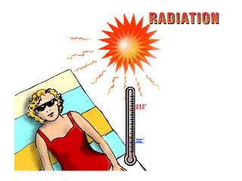
Radiation
Radiation is heat
transfer through space
by electromagnetic waves
Unlike Conduction and Convection,
Radiation can occur in empty space,
as well as in solids, liquids, and gases.
Waves such as visible light, infrared, and ultraviolet light are examples of radiation
Notes:
Instructional Approach(s): The teacher should present the information on the slide while the students record the important information on their notes

Slide 3
Radiation
Radiation travels in straight lines
True/False
Radiation can travel through a vacuum
True/False
Radiation requires particles to travel
True/False
Radiation travels at the speed of light
True/False

Slide 4
The process by which heat travels without the help of material medium is called RADIATION
The hotter something is, the more is the heat radiated.
This radiated heat is called RADIANT HEAT/ RADIANT ENERGY.
Till EQULIBRIUM TEMPERATURE is reached

Slide 5
What happens when radiant heat falls on an object?
Some of it is absorbed and some is reflected.
Absorbtion of radiant energy depends upon:-
Colour of the object
Nature of surface
SHINY SMOOTH SURFACES ARE BETTER REFLECTORS.
DULL ROUGH SURFACES ARE BETTER ABSORBERS.
Black objects are, in fact, best absorbers and best radiators of heat energy.

Slide 6
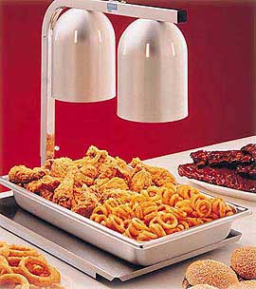
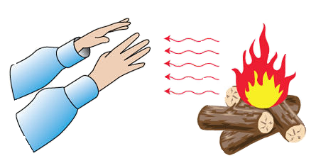
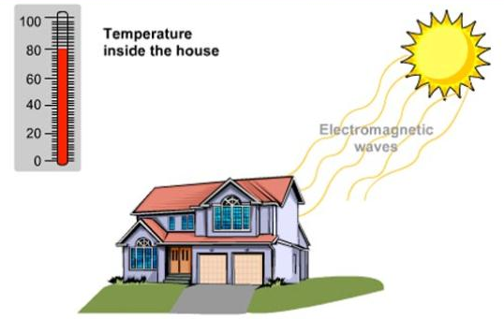
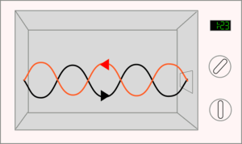
Radiation
Notes:
Instructional Approach(s): The teacher should use the images on the slide to illustrate examples of radiation.

